Slide 1
REAL ESTATE MANAGEMENT SYSTEM
FRONTEND DEVELOPMENT WEBSITE FOR DSP INFRA DEVELOPERS

Slide 2
BACKGROUND STORY OF THIS WEBSITE MAKING?
DSP INFRA DEVELOPERS

Slide 3
What is real estate management system ?
A Real Estate Management System (REMS) is a software application or platform designed to help real estate professionals and property owners streamline and manage various aspects of their real estate operations. It provides tools and features to facilitate the management of properties, tenants, leases, financial transactions, maintenance, and other related tasks. The primary goal of a real estate management system is to improve efficiency, organization, and decision-making within the real estate industry.
Real Estate Management Systems are used by various real estate professionals, including property managers, landlords, real estate agents, and property management companies. They are particularly useful for individuals or organizations with multiple properties to manage, as they can significantly simplify and streamline the day-to-day operations of the real estate business.

Slide 4
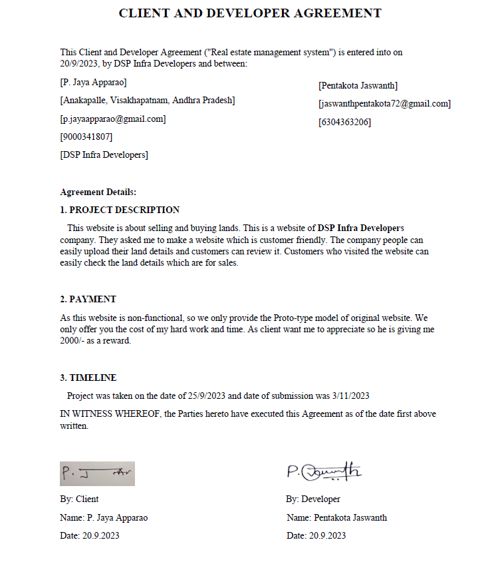
AGREEMENT DETAILS BETWEEN CLIENT AND ME AS A DEVELOPER

Slide 5

REQUIRMENTS OF MY CLIENT IN HIS WEBSITE
GOOD USER INTERFACE
CUSTOMER LOGIN
CUSTOMER SIGNUP
COMPANY DETAILS
PLOTS UNDER SALE
APPOINTMENT BOOKING
CONTACT THE LAND BROKER/
IMAGE RELATED TO THE PLOT
PROPERTY TYPES

Slide 6
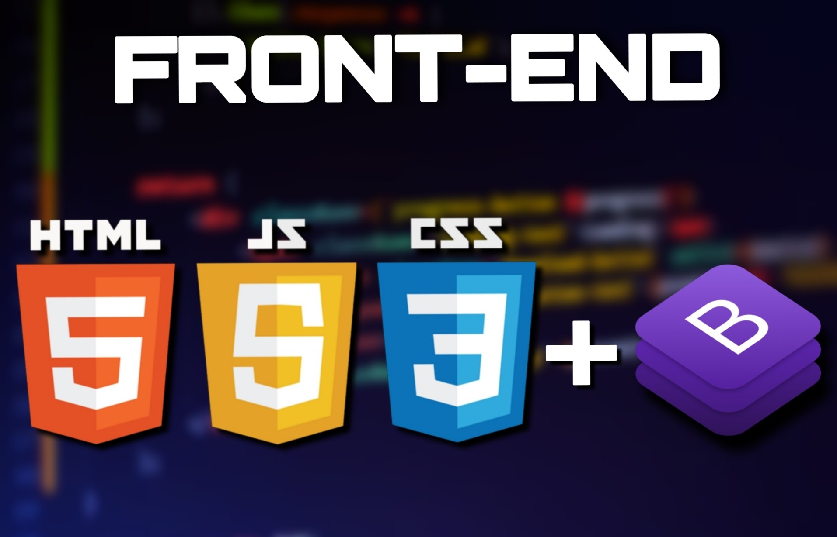
TECHNOLOGIES USED IN THE WEBSITE
HTML(HYPER TEXT MARK-UP LANGUAGE)
CSS
JAVASCRIPT
BOOTSTRAP
JQUERY

Slide 7
LET’S MOVE ON TO THE WEBSITE…
DSP INFRA DEVELOPERS

